Slide 1
Assignment 5
Marissa Defratti

Slide 2
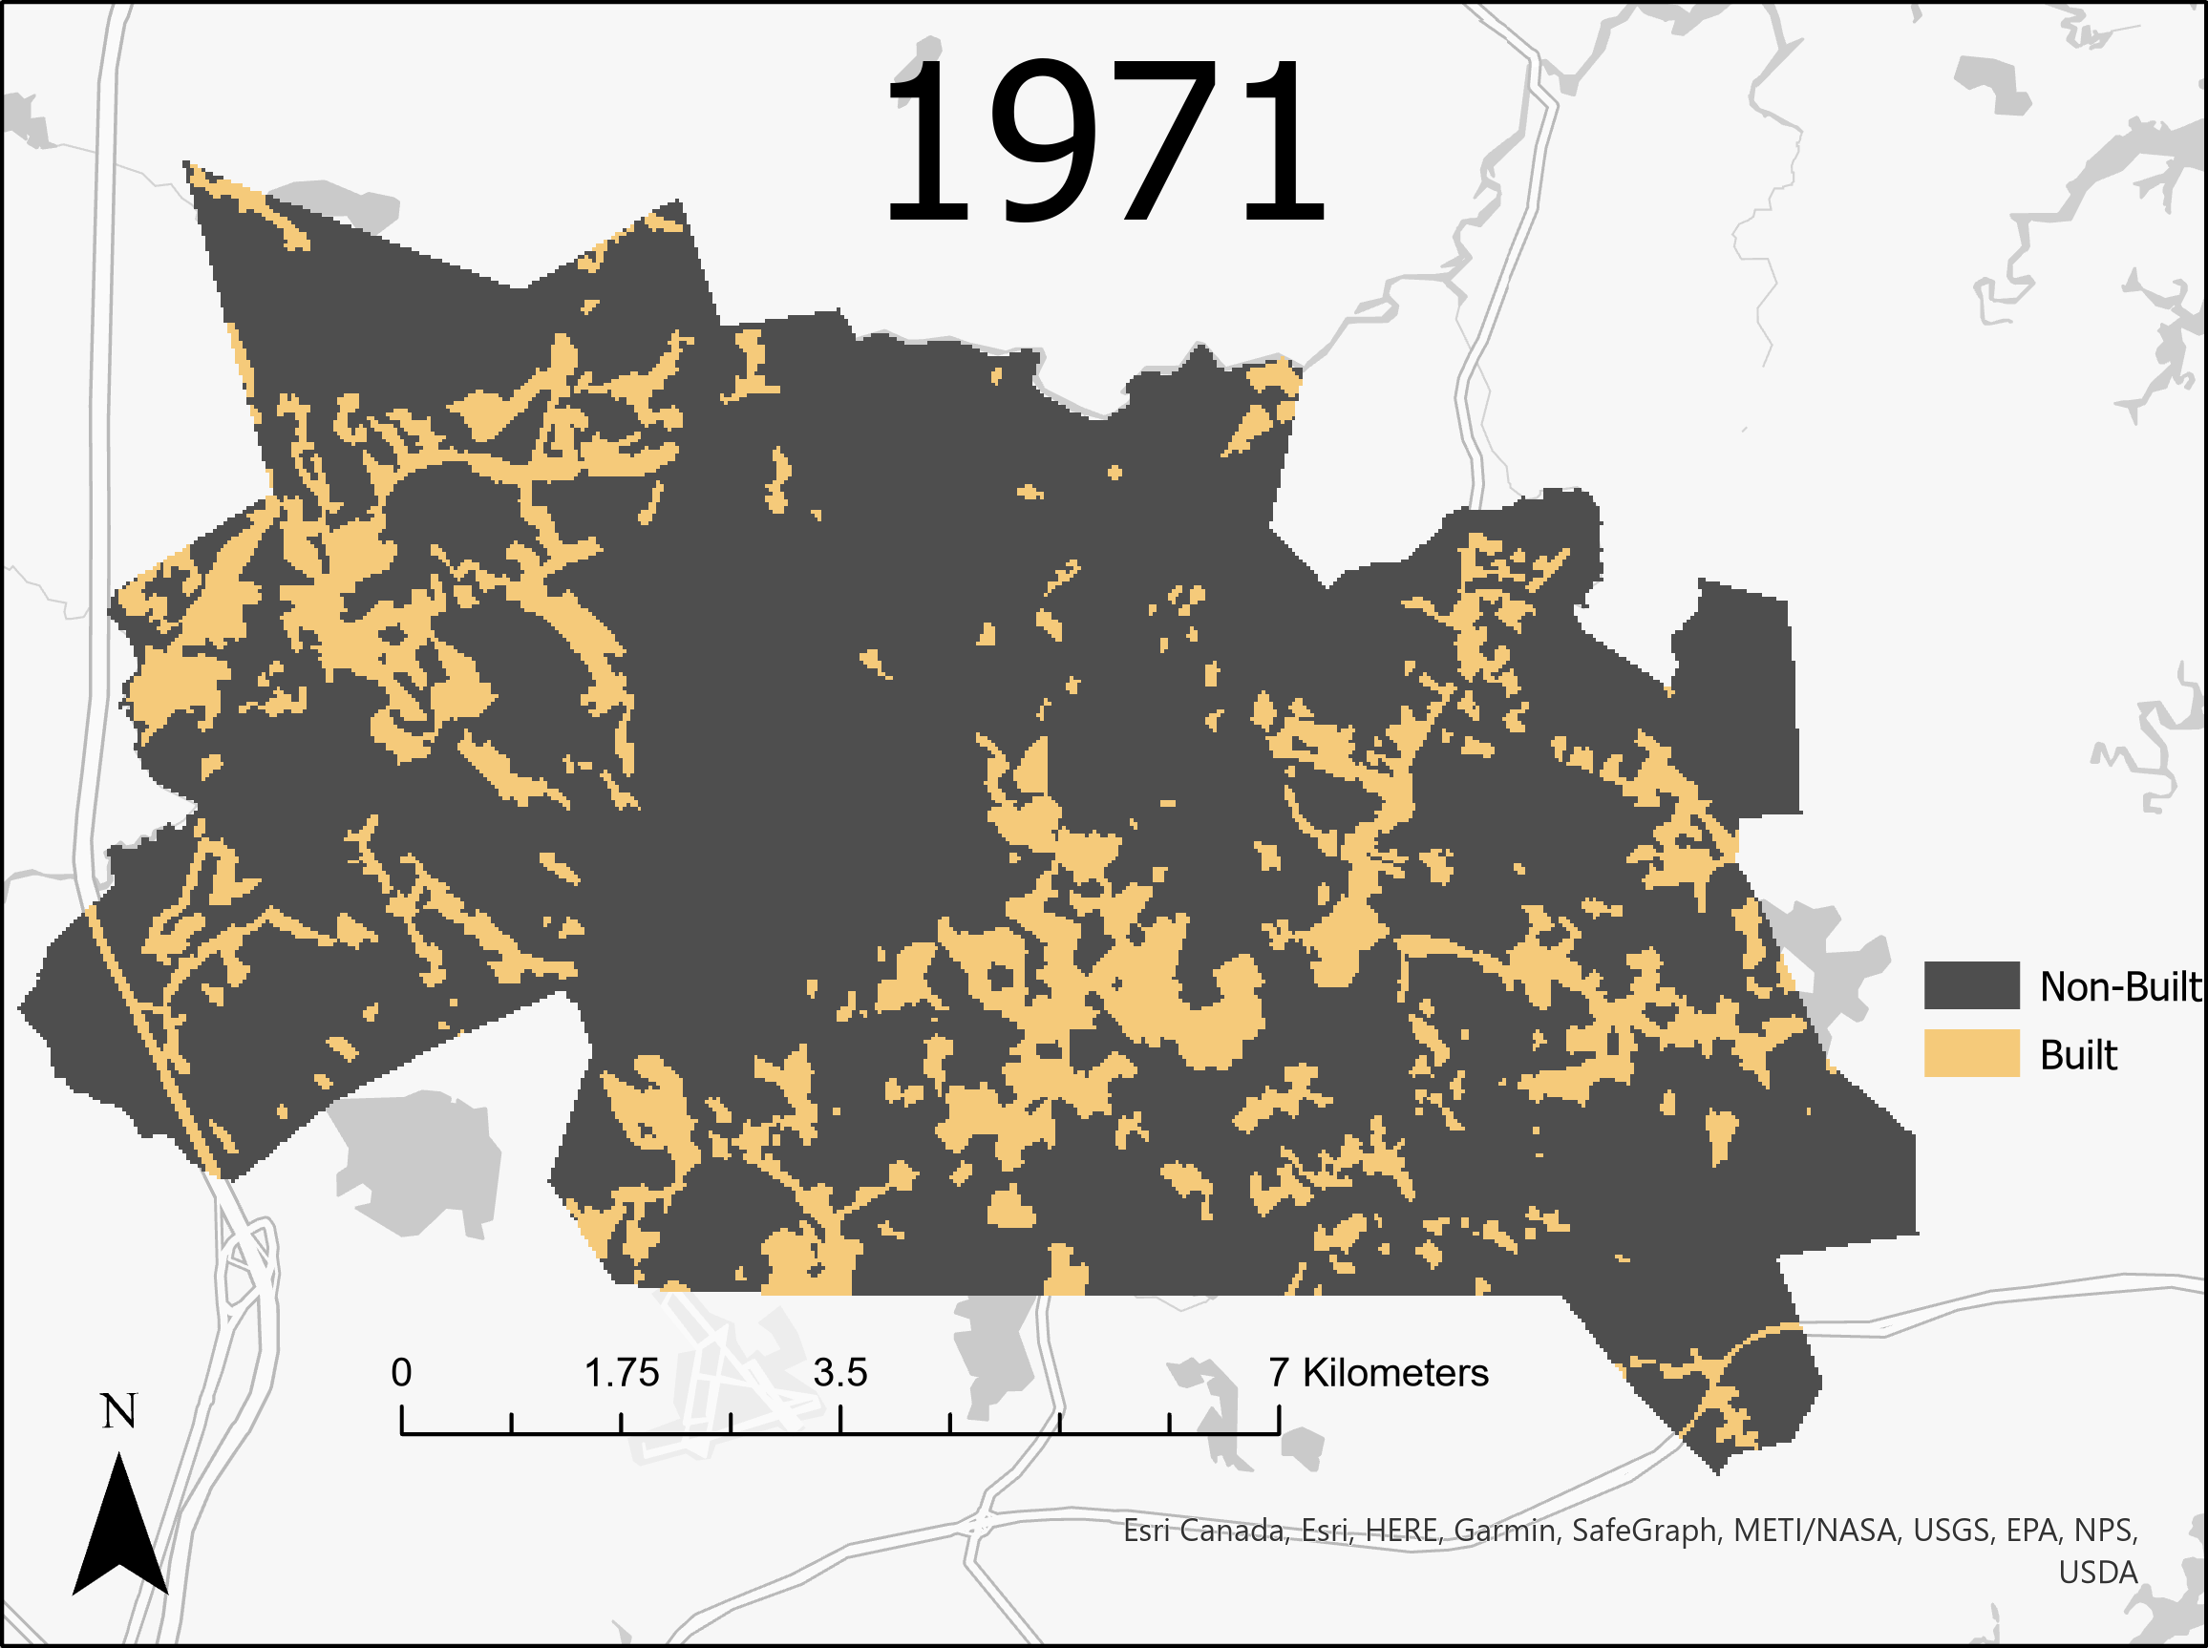
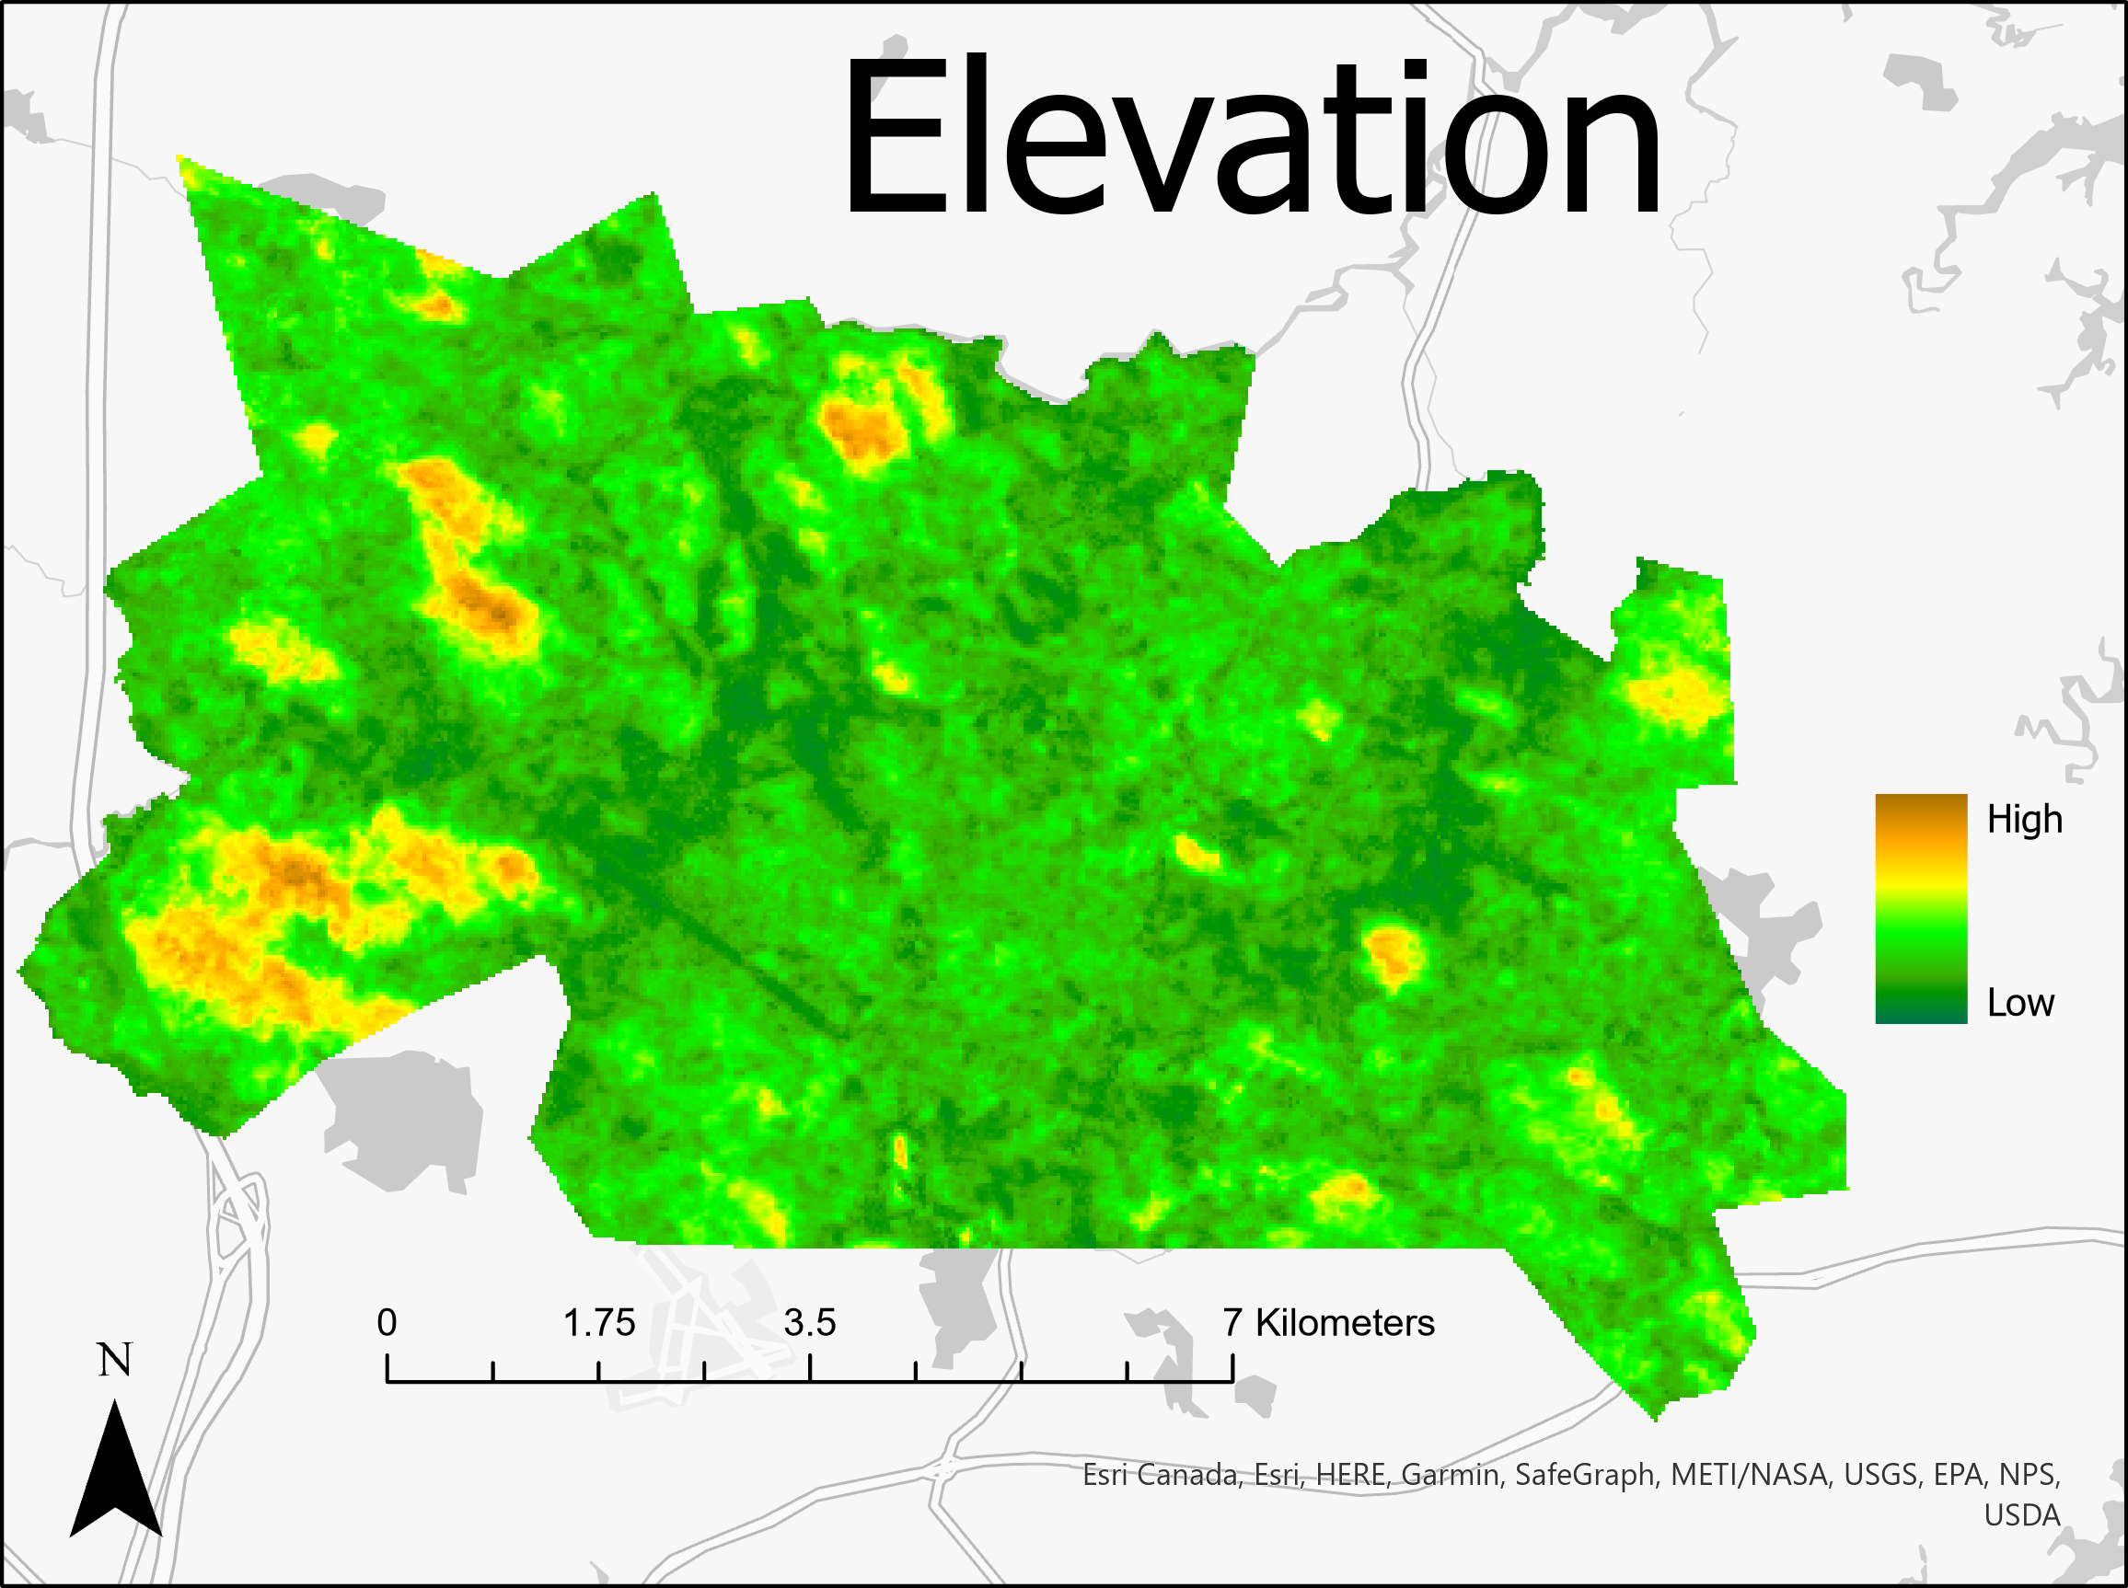
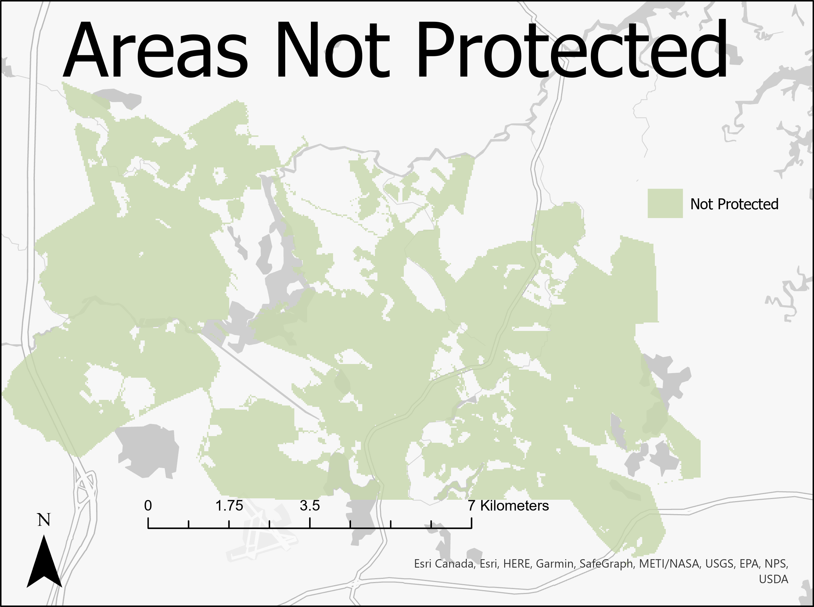
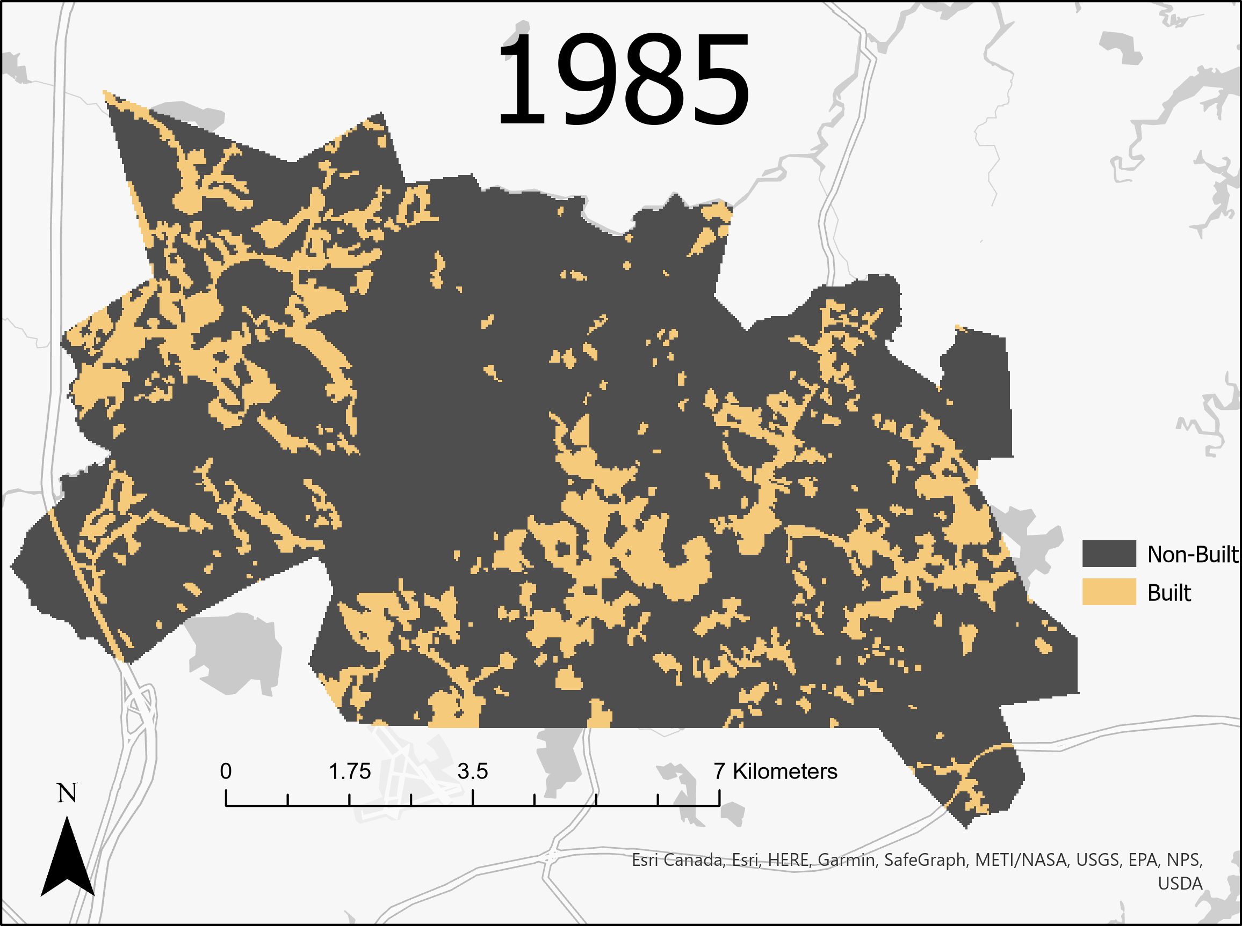
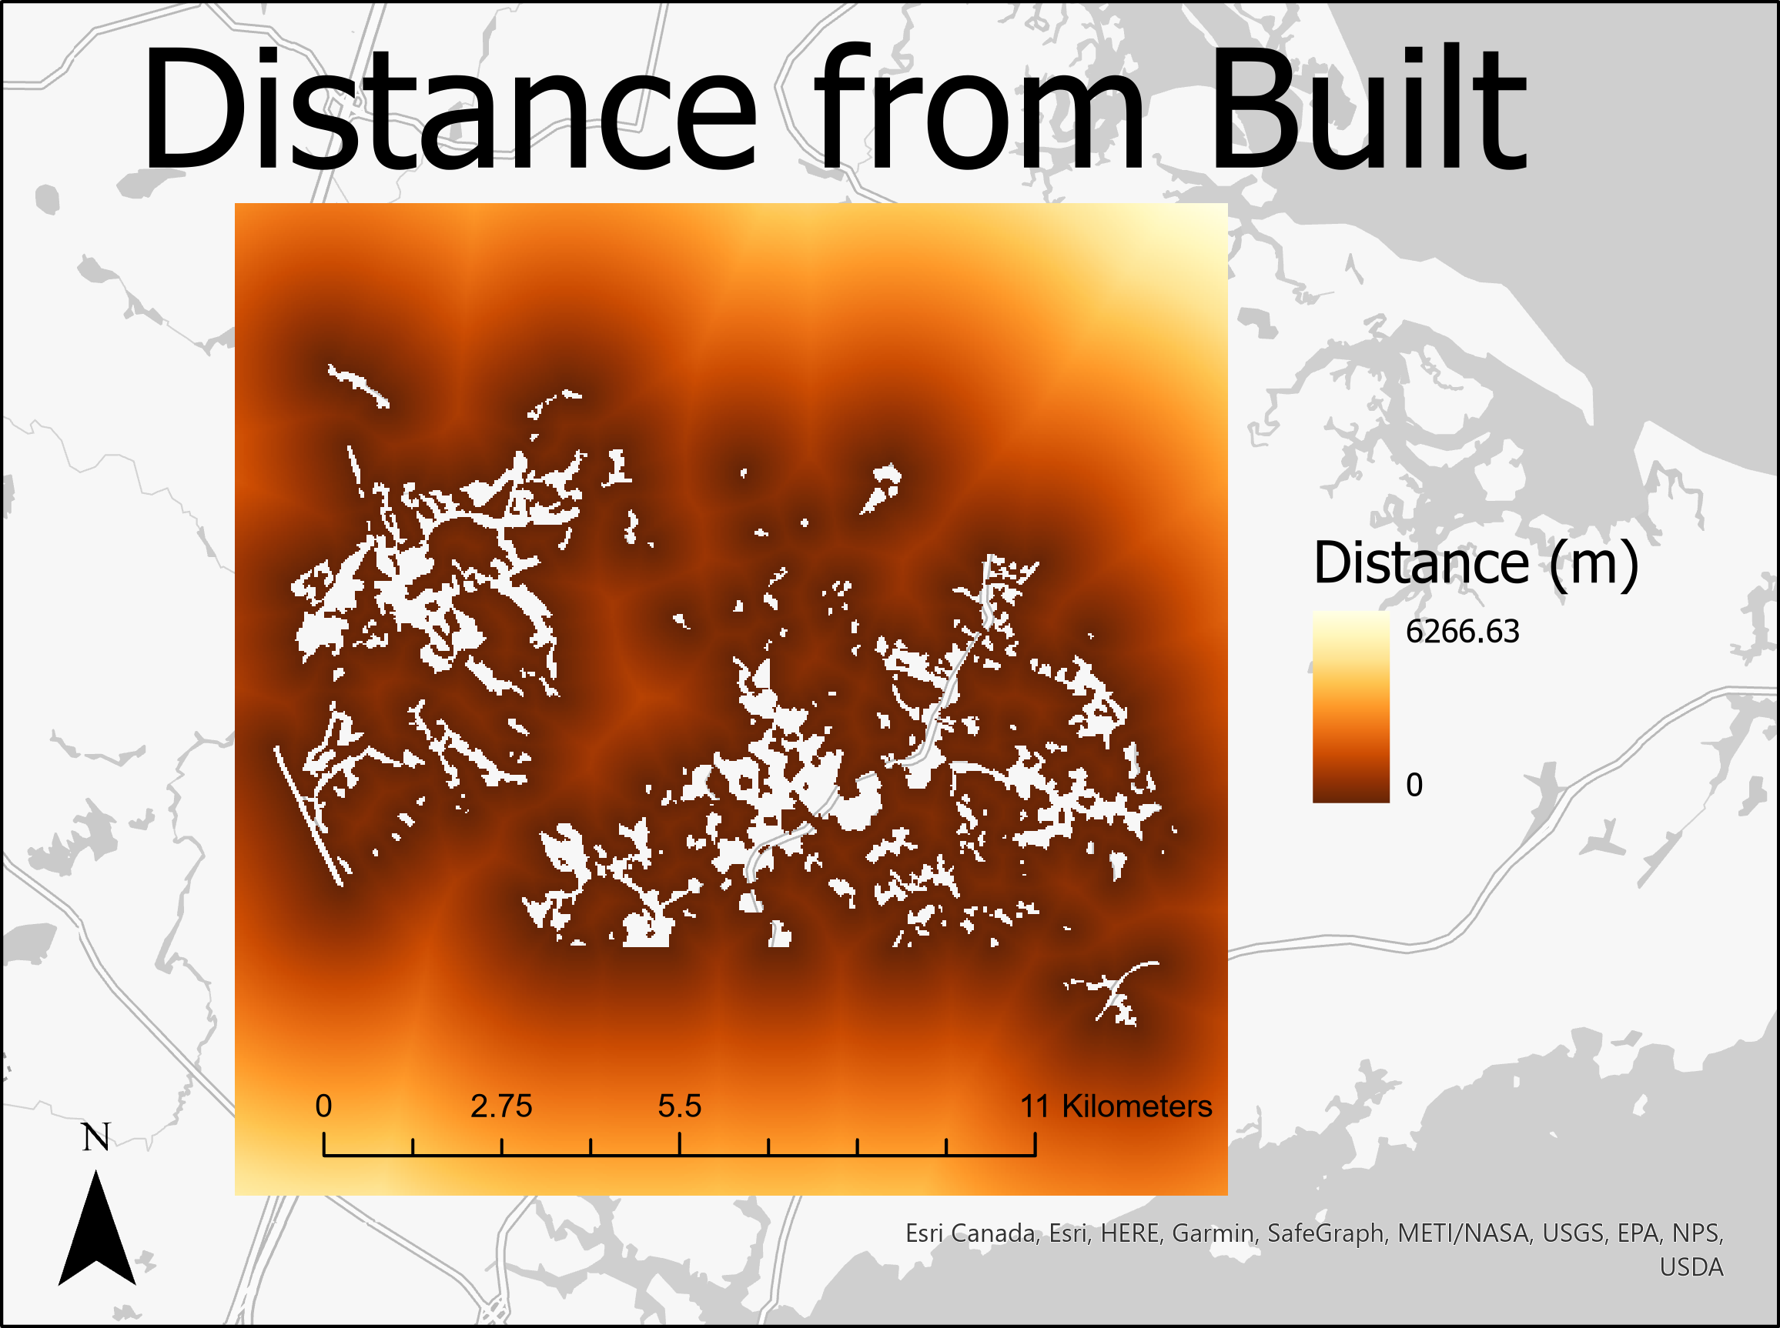
Input Maps
Notes:
Input maps (earlier image, later image, independent variable of distance, independent variable of elevation, Boolean protection map)

Slide 3
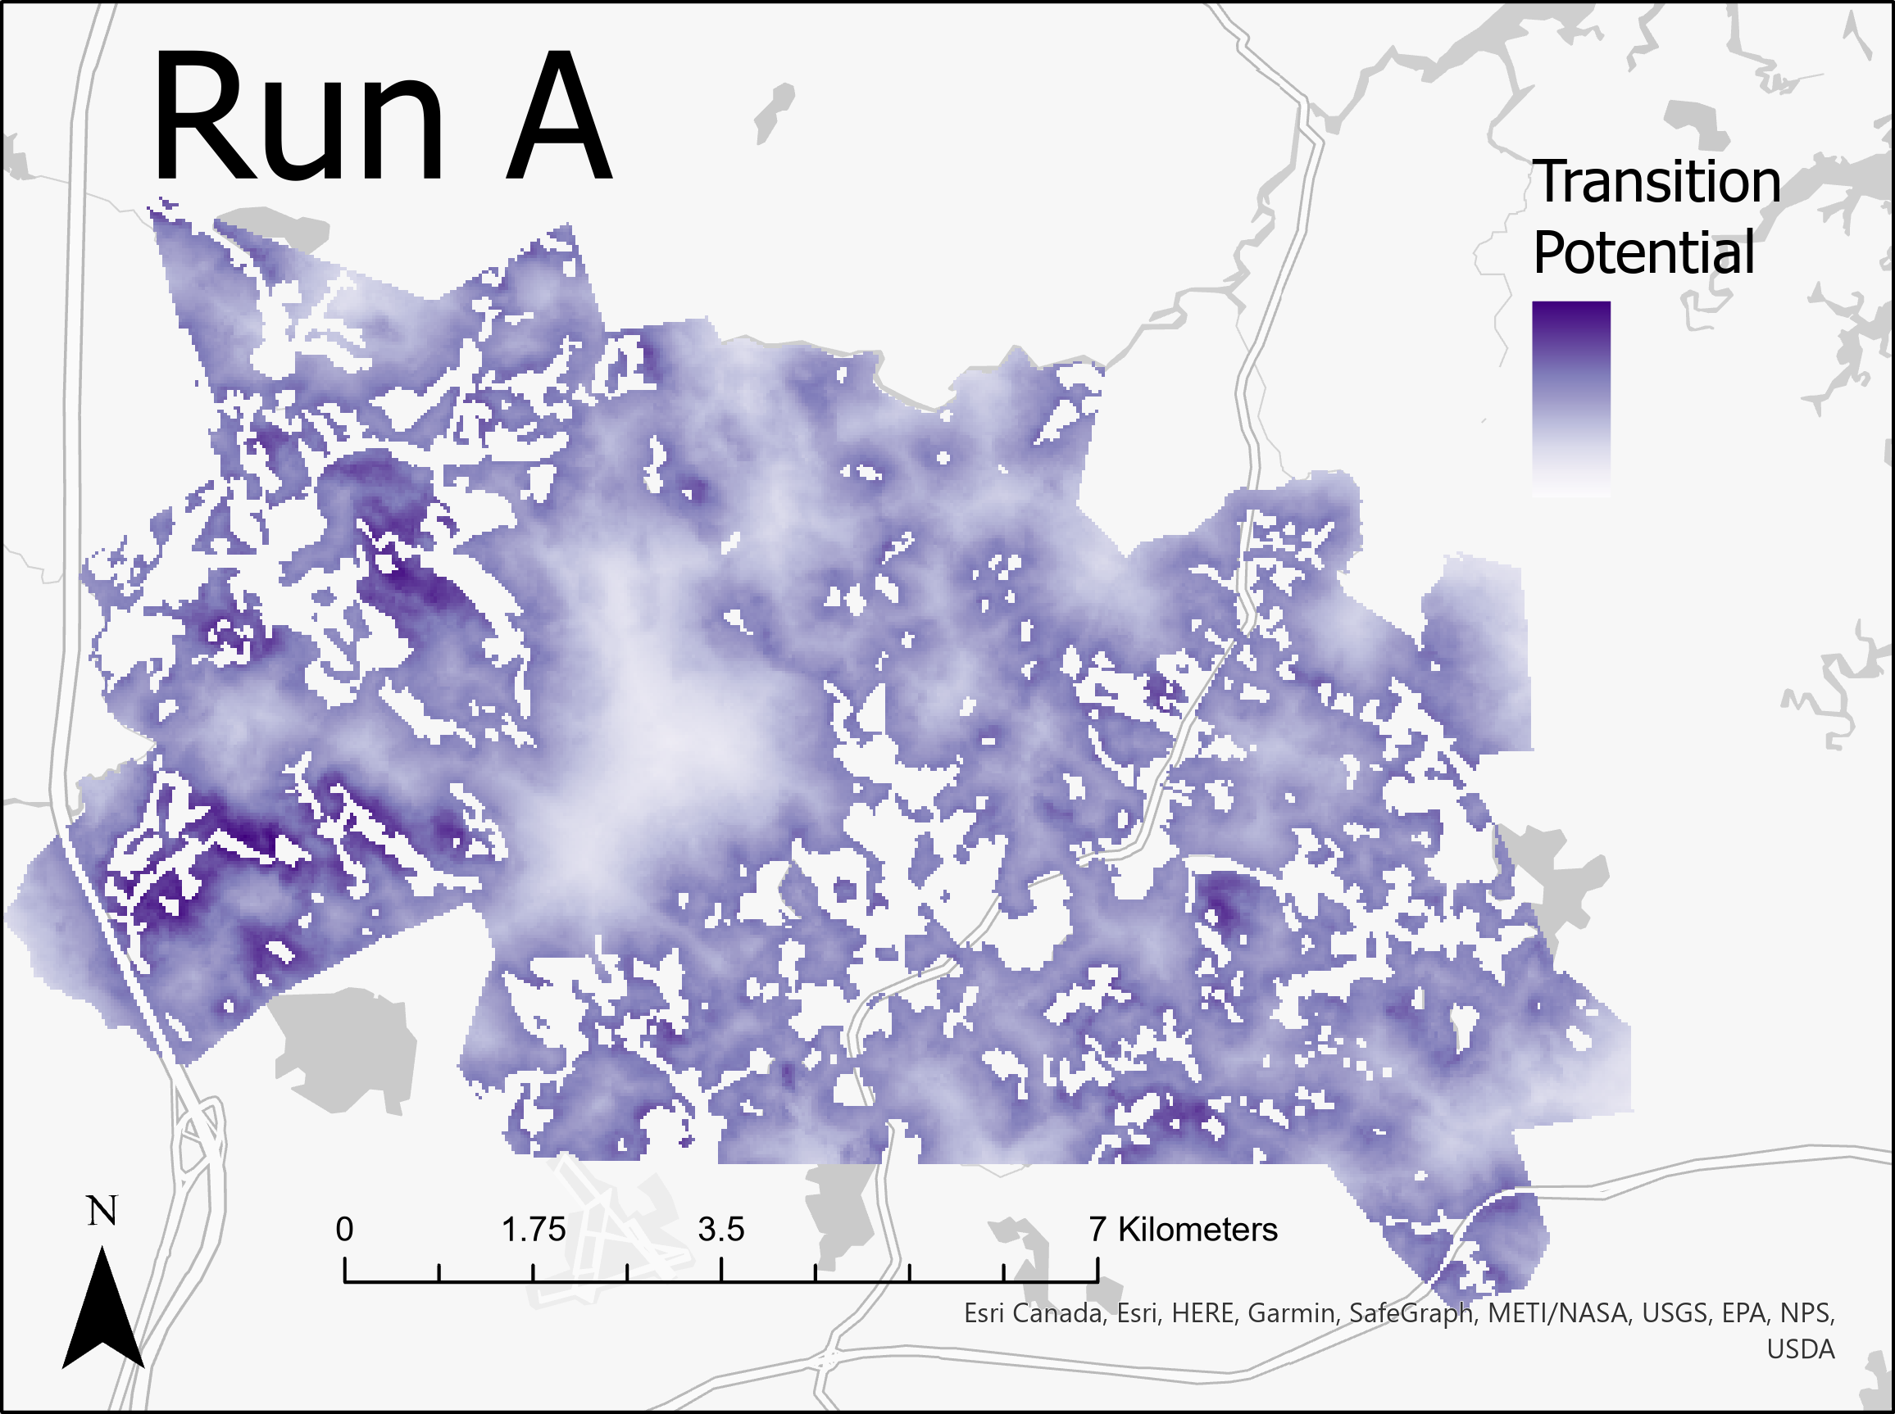
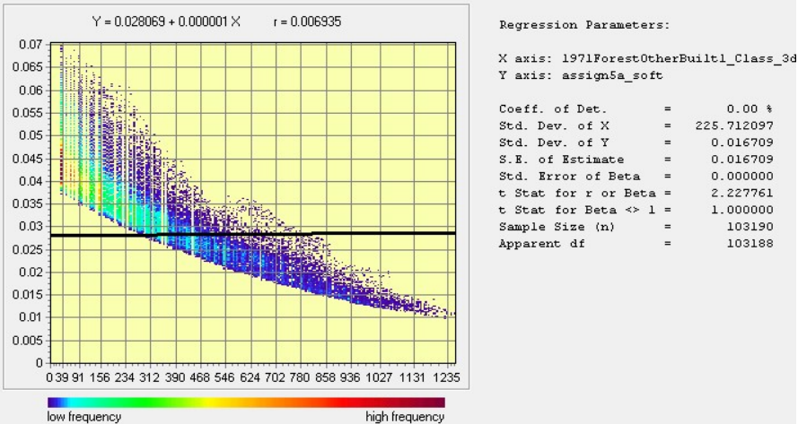
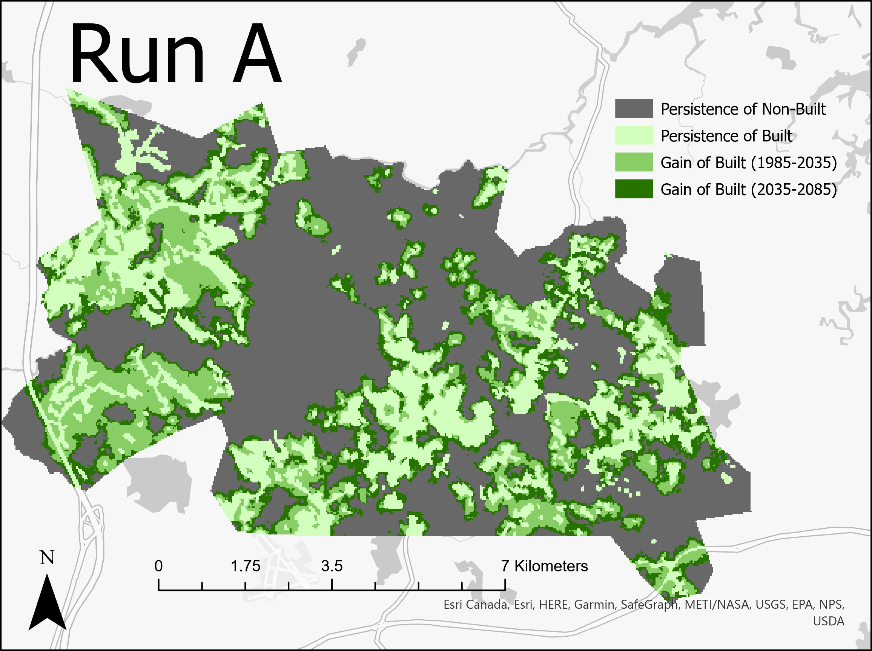
Run A
Category | Pixels
Persistence of Non-Built | 48,547
Persistence of Built | 22,279
Gain of Built (2035-2085) | 16,182
Gain of Built (1985-2035) | 16,182
Notes:
RunA Analysis: (soft output map, CROSSTAB map, Regress ScatterPlot)
Explain: # of pixels of gain during each stage & why; The number of pixels gained during each stage is evenly split based on the Markov Matrix input of 40% transition; 20% of the pixels were allocated to the first stage and 20% were allocated to the second stage.
How LCM uses transition potential map; For Run A, LCM used a logistic regression without sampling or zoning constraints. It is measuring the association between the independent variables (Elevation and Distance from Built) layers, and where the increase in built occurred between 1971-1985.
Avg. transition potential for each soft prediction map; 0.035933. The regression plot indicates that transition potential decreases with distance.
Does a larger average transition potential indicate a larger quantity of built area after 1985? A larger average transition potential indicates that there are more ideal spaces for the allocation of built, however (I think?) the quantity is still primarily controlled by the Markov Matrix. So no, not necessarily.

Slide 4
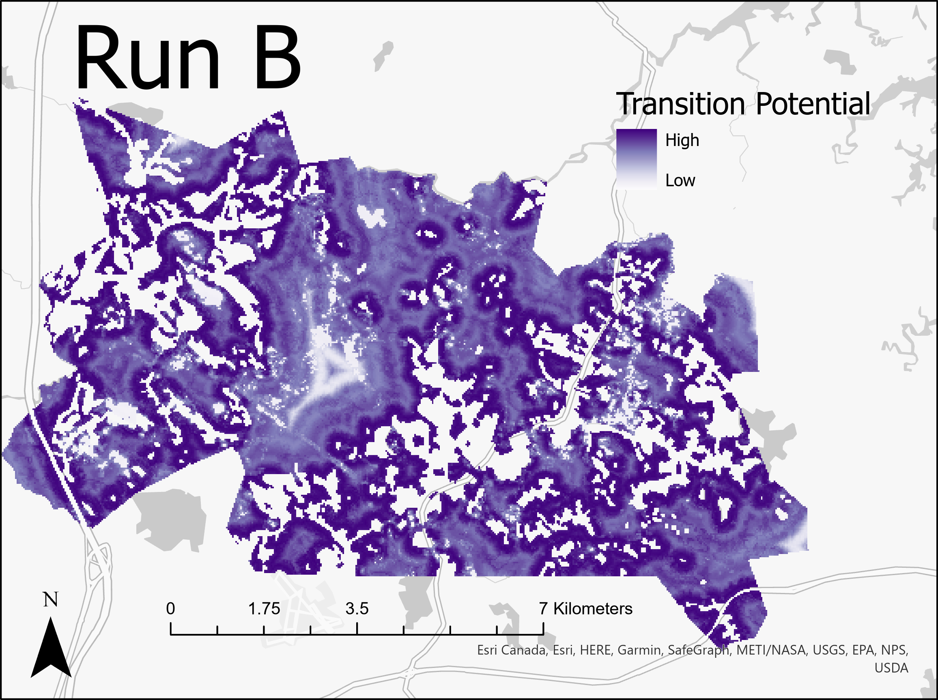
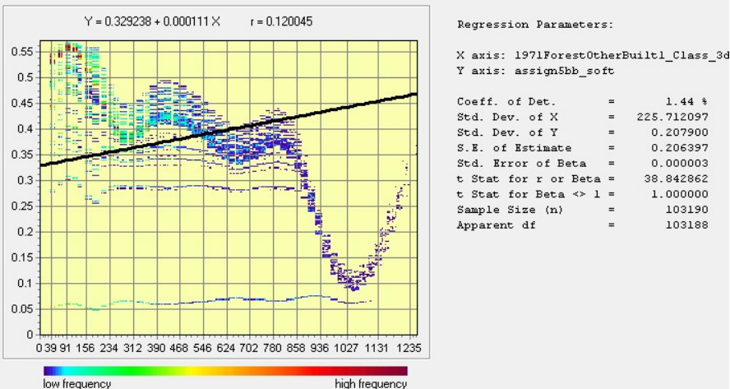
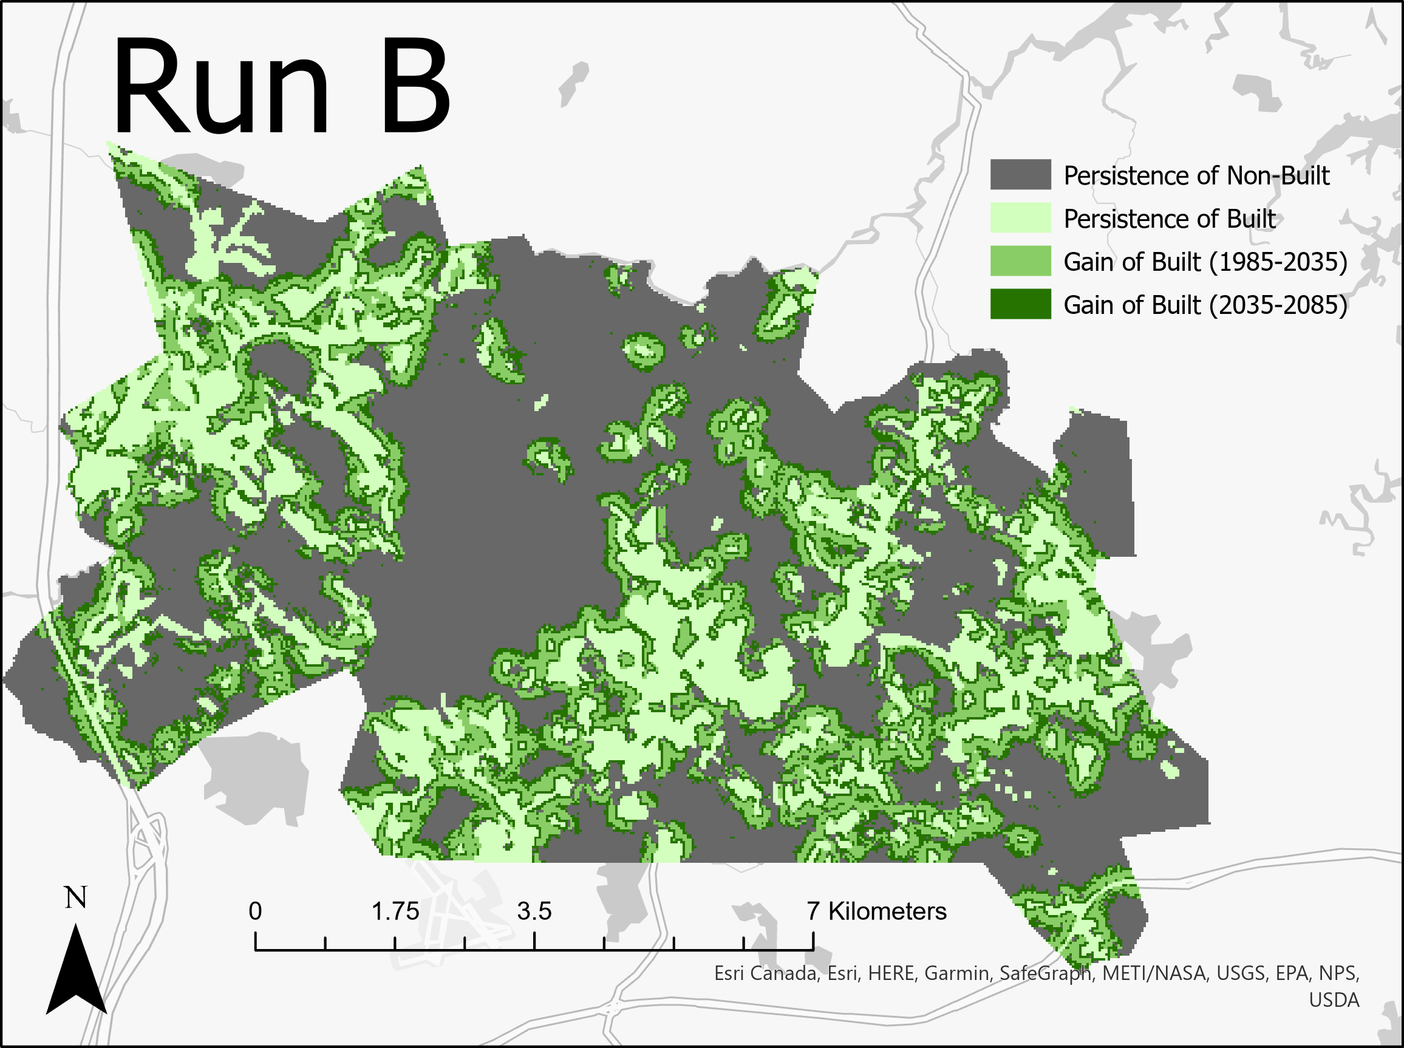
Run B
Category | Pixels
Persistence of Non-Built | 48,547
Persistence of Built | 22,279
Gain of Built (2035-2085) | 16,182
Gain of Built (1985-2035) | 16,182
Notes:
RunB Analysis: (soft output map, CROSSTAB map, Regress ScatterPlot)
Explain: # of pixels of gain during each stage & why; The number of pixels gained during each stage is evenly split based on the Markov Matrix input of 40% transition; 20% of the pixels were allocated to the first stage and 20% were allocated to the second stage.
How LCM uses transition potential map; For Run B, LCM used a WNL with sampling and without zoning constraints. Sampling allows the algorithm to perform a supervised classification of the allocation of pixels, which is determined by the elevation and built distance inputs.
Avg. transition potential for each soft prediction map; 0.035933.
Does a larger average transition potential indicate a larger quantity of built area after 1985? *Same as Run A.

Slide 5
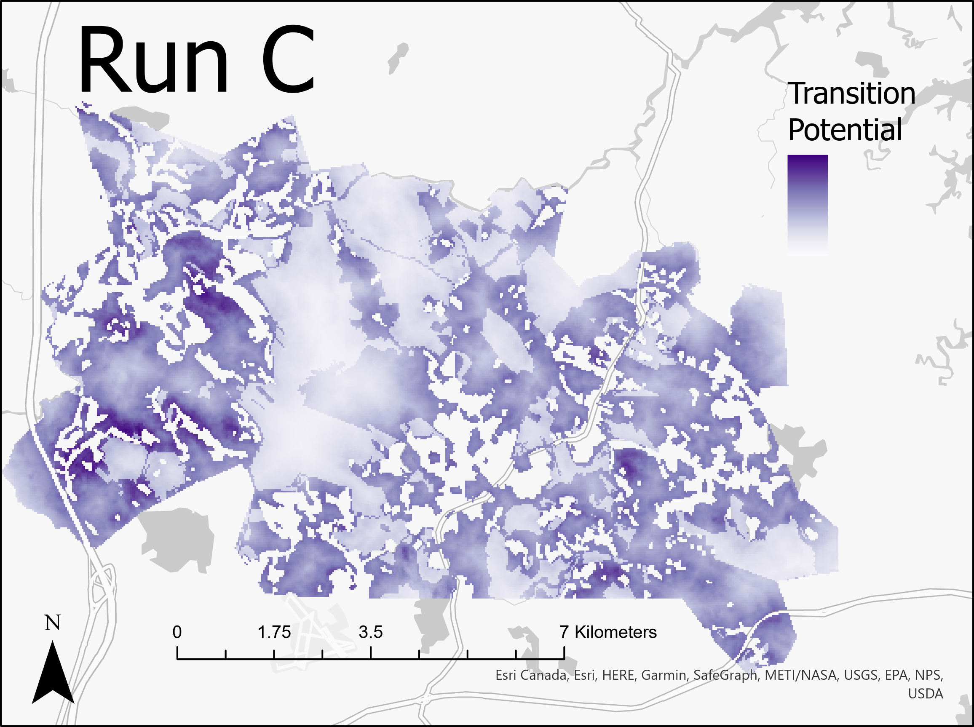
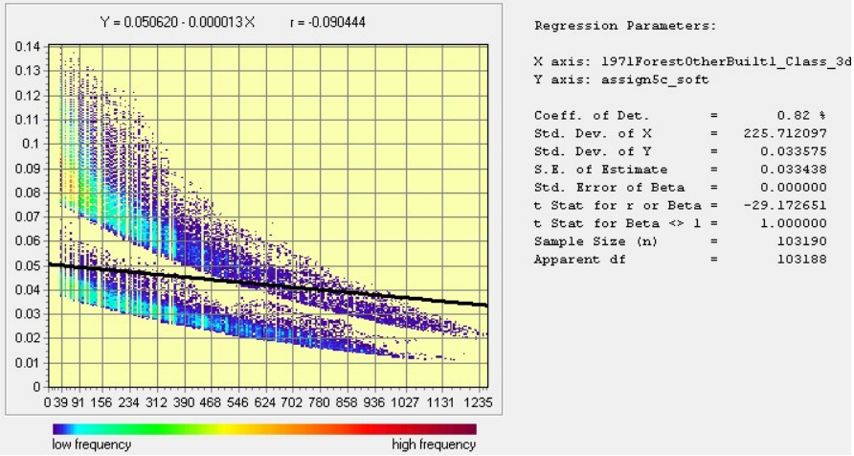
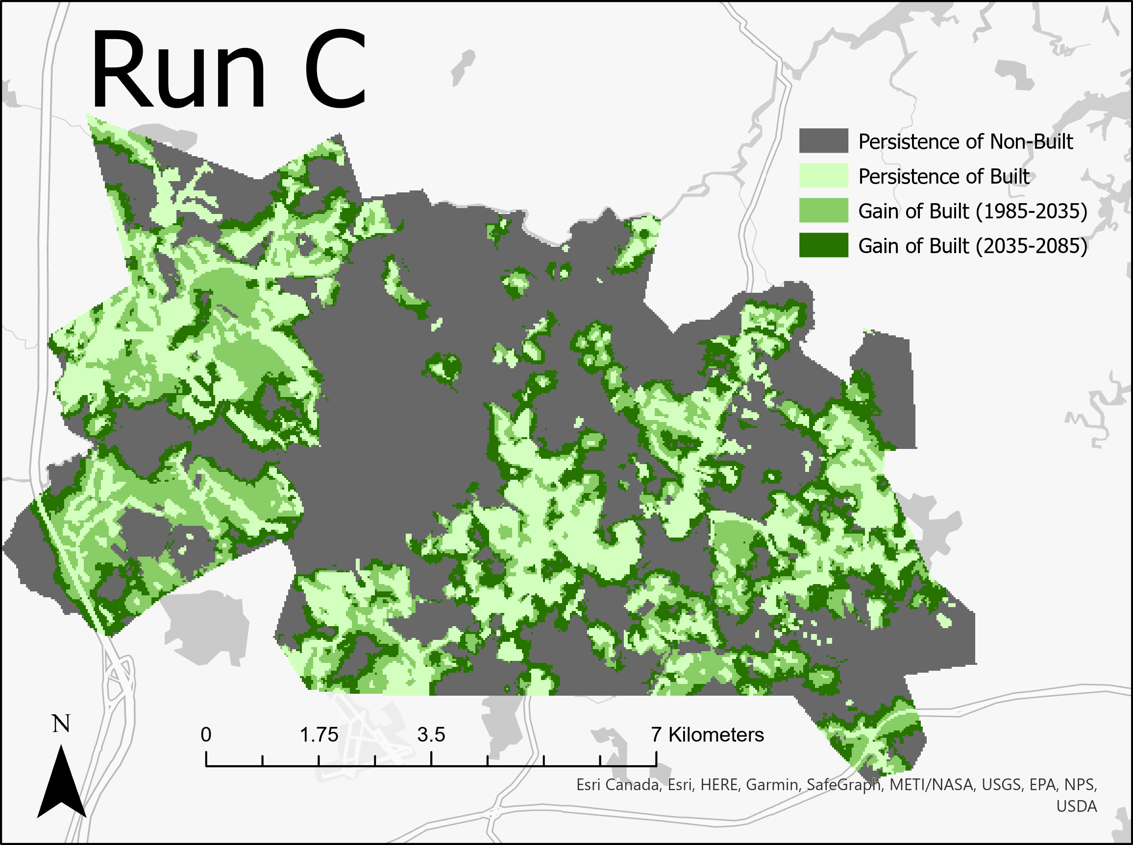
Run C
Category | Pixels
Persistence of Non-Built | 48,547
Persistence of Built | 22,279
Gain of Built (2035-2085) | 16,182
Gain of Built (1985-2035) | 16,182
Notes:
RunC Analysis: (soft output map, CROSSTAB map, Regress ScatterPlot)
Explain: # of pixels of gain during each stage & why; The number of pixels gained during each stage is evenly split based on the Markov Matrix input of 40% transition; 20% of the pixels were allocated to the first stage and 20% were allocated to the second stage.
How LCM uses transition potential map; For Run C, LCM used a WNL with zoning constraints based on protected areas. Sampling allows the algorithm to perform a supervised classification of the allocation of pixels, which is determined by the elevation and built distance inputs. Allocation of built was determined by first excluding all pixels in protected areas, and then using the elevation input.
Avg. transition potential for each soft prediction map; 0.061017. The regression plot indicates that generally transition potential decreases with distance. The ‘double-line’ indicates transition potentials vary for pixels at the same distance – most likely because the protected areas are both close and far from built areas.
Does a larger average transition potential indicate a larger quantity of built area after 1985? No

